Slide 1
Project Mahalo
Analyze SAT and ACT participation in Hawaii

Slide 2


Slide 3
Problem Statement
As a data analyst for the department of education of Hawaii, I am tasked with analyzing the national average performance on SAT & ACT tests
Find factors influencing scores
Understand Hawaii's standing when it comes to these tests
Suggest improvements through data analysis & external research

Slide 4
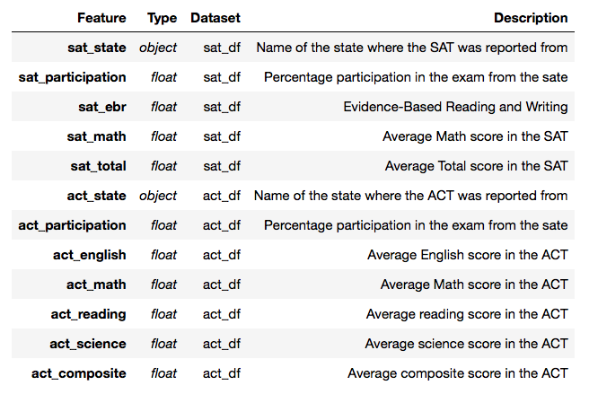
The Dataset
The final dataset is a combined set of three different ones
SAT Dataset source: collegevine
ACT Dataset source: prepscholar
2018 SAT & ACT data: Manually collected from collegeboard
This dataset :

Slide 5
Example setters (Good and Bad)
The states which had the highest SAT participation were:
Connecticut
Delaware
District of Columbia
Michigan
Lowest SAT participation:
Iowa
Mississippi
North Dakota
Highest ACT participation: 16 states showed the highest rate of particpation in the ACT’s
Lowest ACT participation: Maine

Slide 6
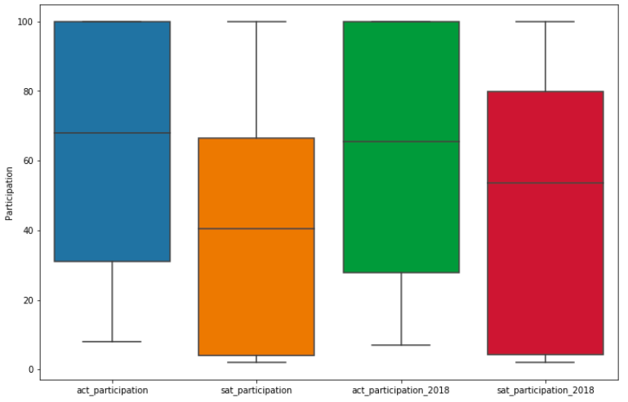
Visualisations
Participation Box plots

Slide 7
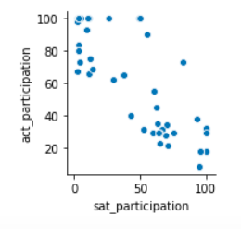
Visualisations (Contd)
How do participation in the tests relate to each other

Slide 8
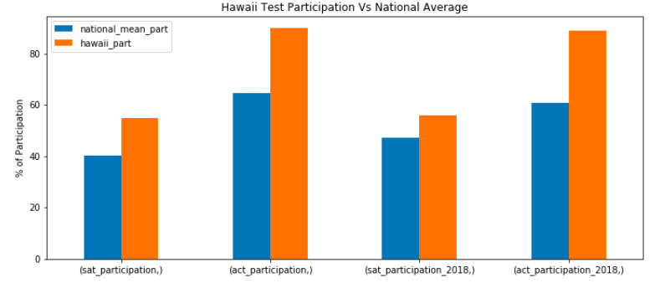
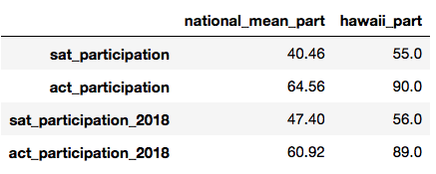
Hawaii’s Participation
Hawaii’s participation rates are clearly much higher than the National average

Slide 9
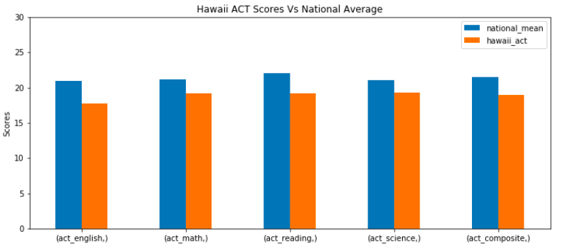
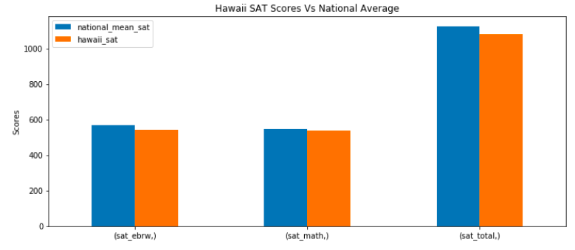
Hawaii’s Performance at the ACT & ACT
ACT Performance
SAT Performance

Slide 10
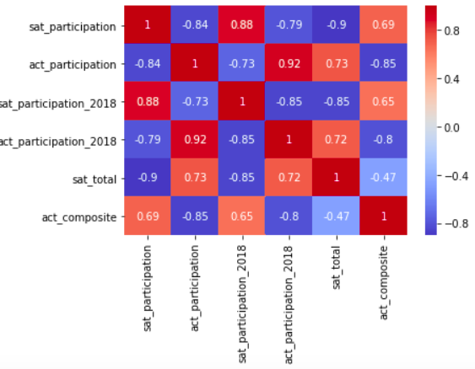
Key Findings
Hawaii’s participation in the tests is higher than the national average
The performance in tests are the key areas to improve for Hawaii
Why were our average scores less?

Slide 11
External Research
Source : Hawaii News Now 2016, Least Intelligent state?
Just 1 in 10 Hawaii public school students in the Class of 2016 earned ACT scores considered ready for college-level coursework
Public schools started making the ACT mandatory for all Hawaii public school juniors in 2014.
Due to lowest performance across IQ stats, SAT, ACT, and % of college graduates, Hawaii was called the least intelligent state in 2015

Slide 12
Conclusions & Further research
Student adversity is an important factor to be researched
SAT will be adding an adversity factor for forthcoming tests to account for the students socio-economic backgrounds (Source: nytimes )
Making a test mandatory and increasing participation is not the best approach to achieve performance
Participation and performance are inversely proportional
States like Minnesota should be candidates for further research as it has a very low participation rate and yet high scores on the SAT.

